Slide 1
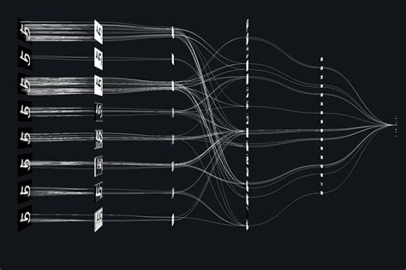
Explainable ML - XML
Pierre Gentine – Columbia University
TRANSCENDING DISCIPLINES, TRANSFORMING LIVES

Slide 2
The problem
Major advances with the deep learning
Radiation
Precipitation
Vegetation
Many (many) weights → black box
2 | XML

Slide 3
How to open up the black box?
Interpreting what is in the gut of deep NN/CNN
Explainable ML
Also helps build trustworthiness in models
→ Right answer for the right reason
A few examples:
Layerwise Relevance Propagation (LRP)
Adjoint/gradient – Saliency maps
SHAPley values
Radiation
Vegetation
3 | XML

Slide 4
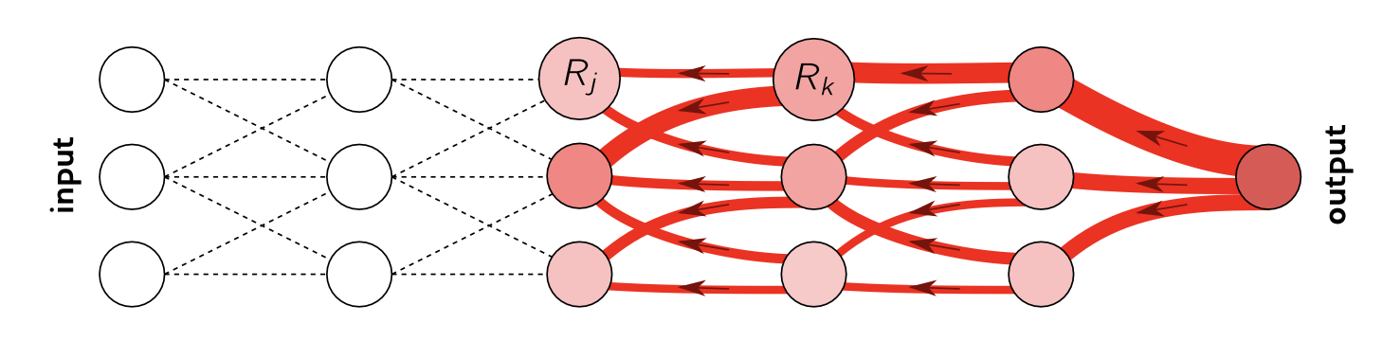
1. Layerwise Relevance Propagation (LRP)
Trying to assess where the information is coming from.
Backward – from output to input that most explain the output
Pass information/relevance backward – a la Kirchoff law (conservation of current):
Radiation
Vegetation
4 | XML
Toms et al. 2020 JAMES

Slide 5
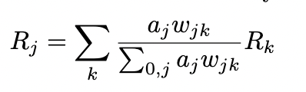
1. Layerwise Relevance Propagation (LRP)
Trying to assess where the information is coming from
Backward – from output to input that most explain the output
Pass information/relevance backward – a la Kirchoff law (conservation of current):
Layer j before layer k
a_{j} – output from layer j (after activation function) w_{jk} - weights
Radiation
Vegetation
5 | XML
Toms et al. 2020 JAMES

Slide 6
1. Layerwise Relevance Propagation (LRP)
Different LRP rules
LRP-0
LRP-epsilon Limit noisy information – filter by small noise epsilon
LRP-gamma Favor positive contributions compared to negative contributions
Equivalent to gradient x input
Vegetation
6 | XML
Montavon et al.

Slide 7
1. Layerwise Relevance Propagation (LRP)
Different LRP rules → generic rule
Can split computation into 4 substeps
What we will do in the notebook – stay tuned
Vegetation
7 | XML
Montavon et al.

Slide 8
1. Layerwise Relevance Propagation (LRP)
Radiation
Vegetation
8 | XML
Toms et al. 2020 JAMES

Slide 9
1. Layerwise Relevance Propagation (LRP)
Radiation
Vegetation
9 | XML

Slide 10
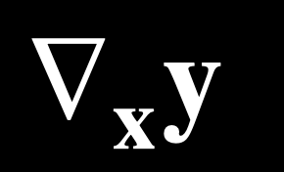
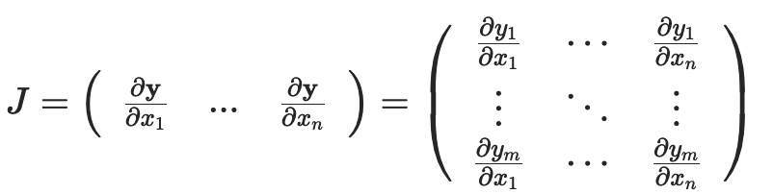
2. Gradient/adjoint
Gradient/adjoint of output y to inputs x
Radiation
Vegetation
10 | XML

Slide 11
2. Gradient/adjoint
Gradient/adjoint of output y to inputs x
Once upon a time: backpropagation Chain’s rule
Same thing!
Radiation
Vegetation
11 | XML

Slide 12
2. Gradient/adjoint
Personal experience:
Non-linear so average over different samples
Use non-dimensional/normalized inputs (and ideally outputs)
Tends to work well for first cut – but can be noisy
Radiation
Vegetation
12 | XML

Slide 13
2. Gradient/adjoint
Personal experience:
Non-linear so average over different samples
Use non-dimensional/normalized inputs (and ideally outputs)
Tends to work well for first cut – but can be noisy
Radiation
Vegetation
13 | XML

Slide 14
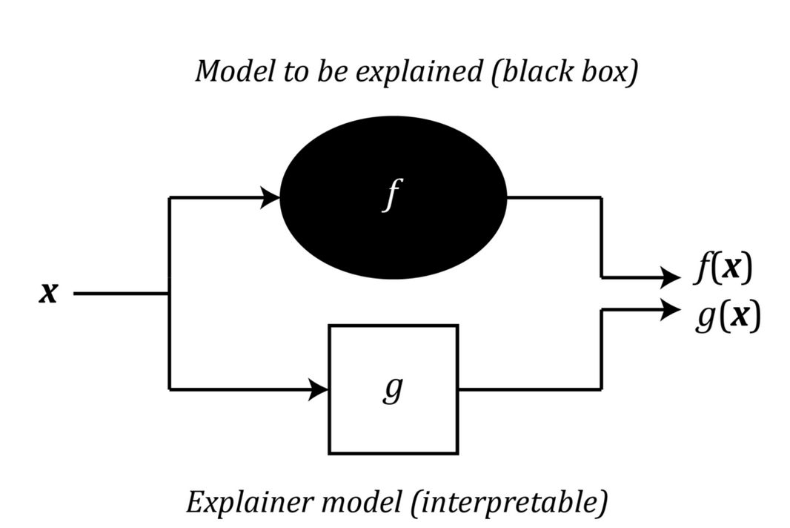
3. Shapley Additive Explanations (SHAP) values
Inspired by Game theory.
Radiation
g mimics f for a single prediction
Vegetation
14 | XML

Slide 15
3. Shapley Additive Explanations (SHAP) values
Inspired by Game theory
Lloyd Shapley (Nobel in Economics)
If we have a coalition C that collaborates to produce a value V
How much did each individual member contribute to the final value?
Radiation
Vegetation
15 | XML

Slide 16
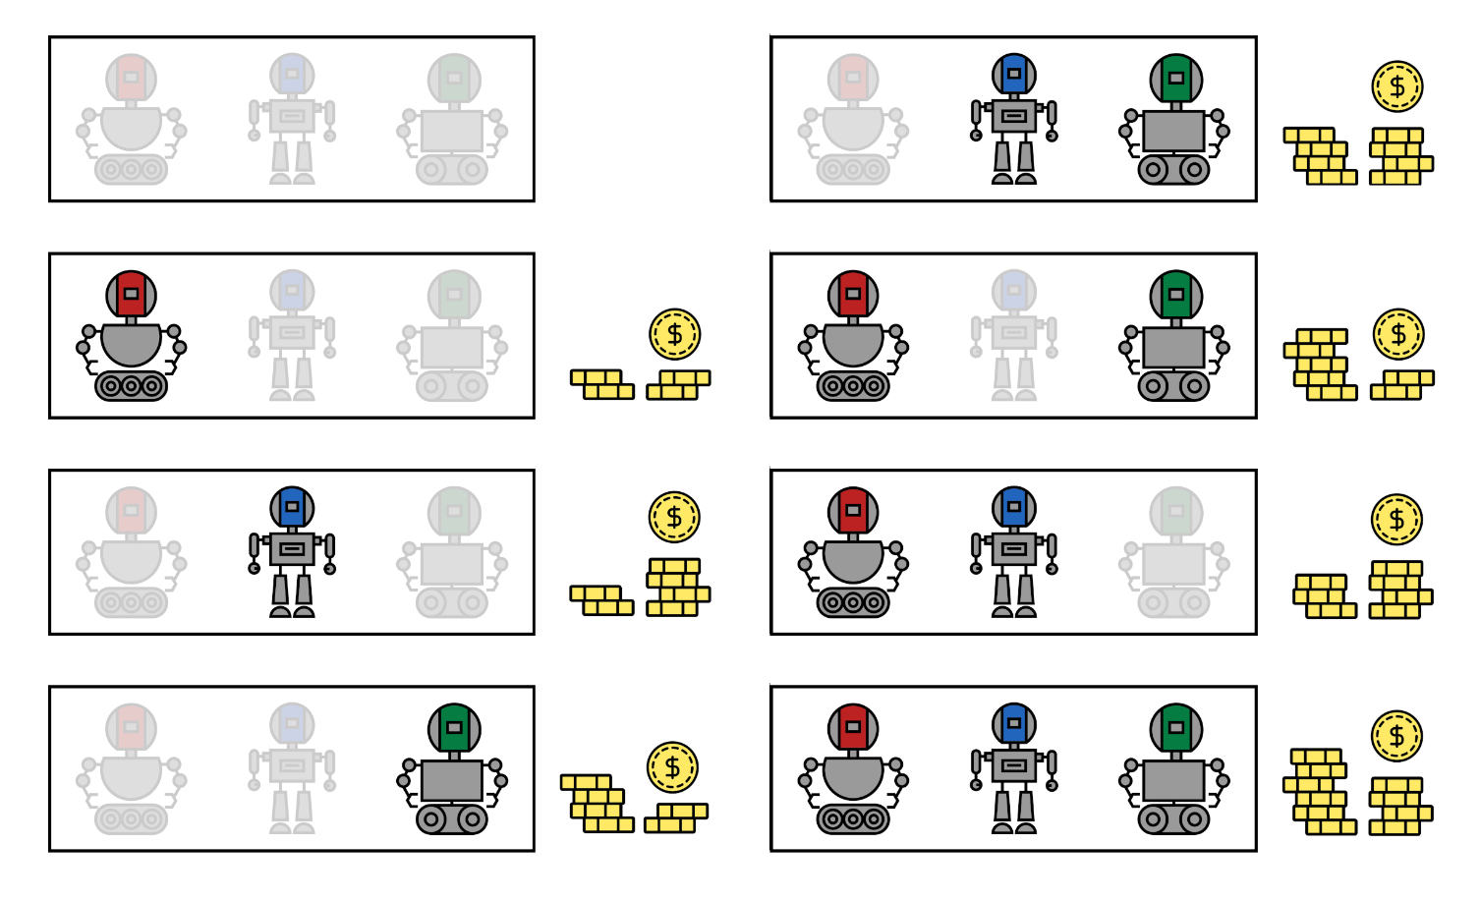
Cooperative Game Theory
A player set (coalition: subset of players)
Cooperative game
A characteristic function that defines the value of coalitions
Rozemberczki et al., 2022

Slide 17
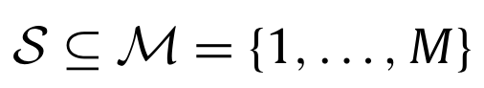
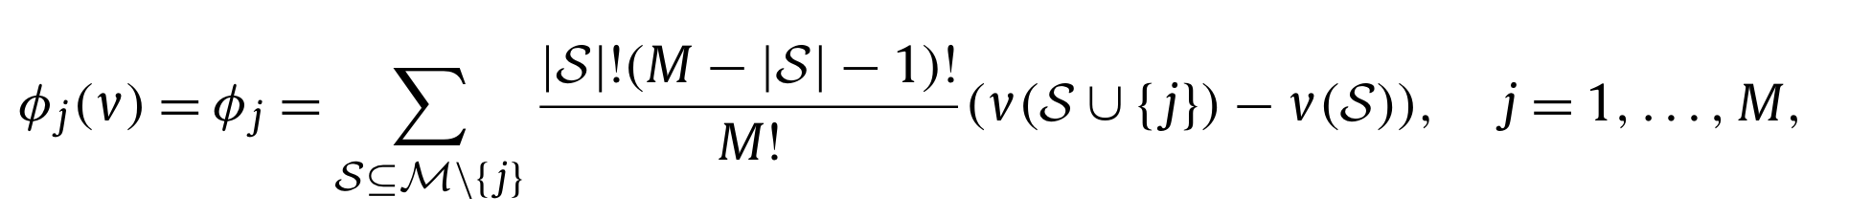
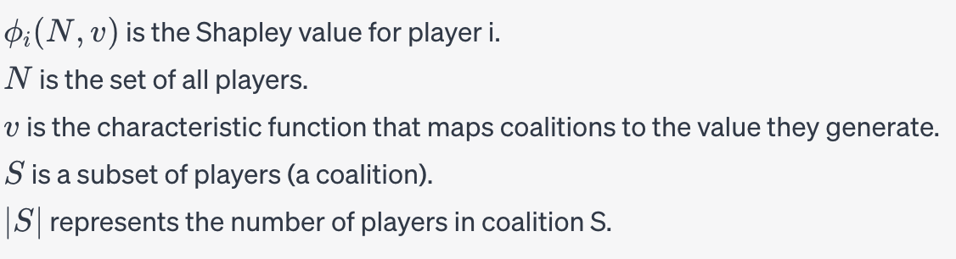
3. SHAP values
Cooperative Game Theory
Coalition:
Shapley value:
Aas et al., 2017

Slide 18


3. SHAP values
Shapley value: is the mean marginal contribution of each feature value across all possible values in the feature space.
Shapley value
Machine learning
Scott Lundberg
Su-In Lee
SHAP:
Shapley Addictive Explanations
A Unified Approach of Interpreting Model Predictions. Lundberg & Lee, 2017

Slide 19
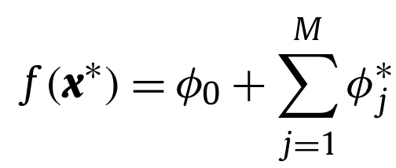
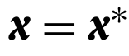
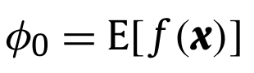
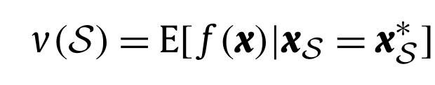
3. SHAP values
Shapley value – machine learning(model-agnostic $f(x)$)
Local explanation :
(Lundberg and Lee, 2017)

Slide 20
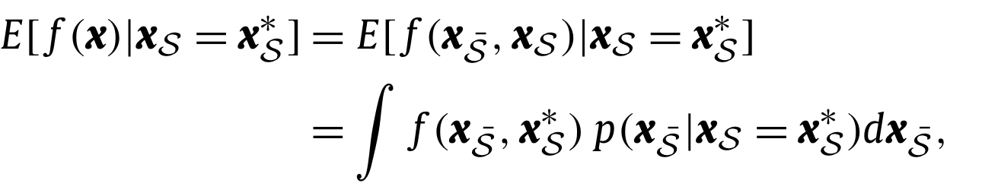
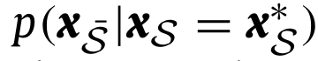
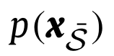

3. SHAP values
$\overline{S}$ is the complement of $S$
(SHAP, Lundberg & Lee, 2017)
(Causal Shapley values, Heskes et al., 2020)

Slide 21
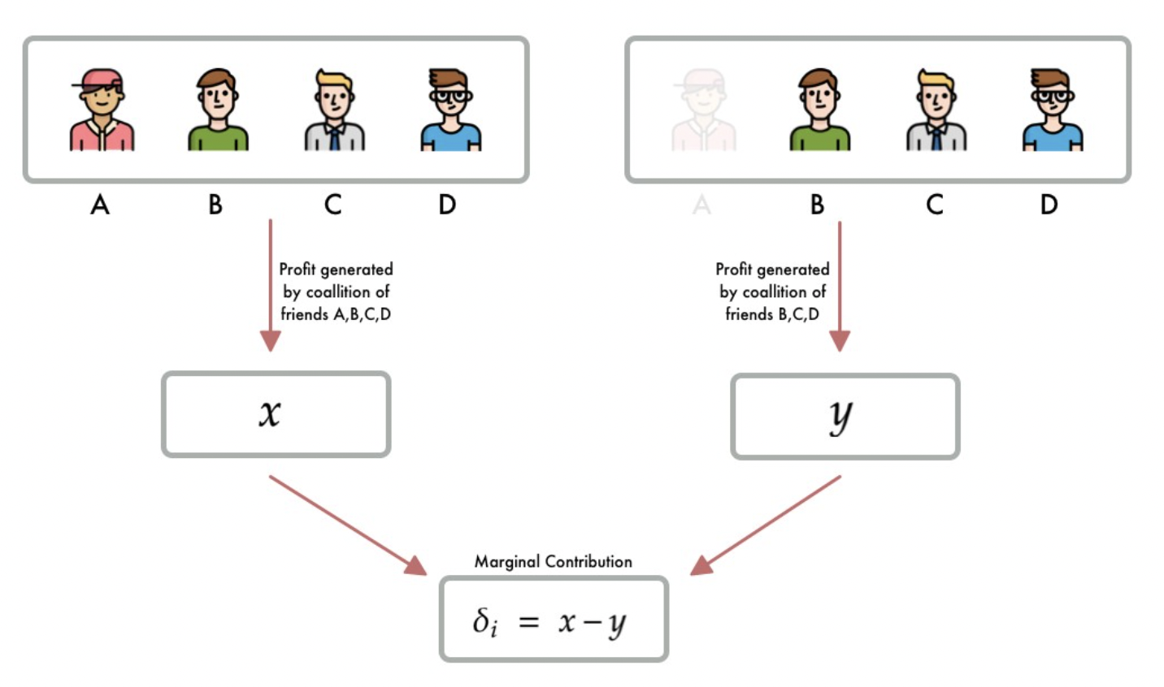
3. SHAP values
Marginal contribution of member A Coalition: subset of features (players)
Radiation
Vegetation
21 | XML

Slide 22
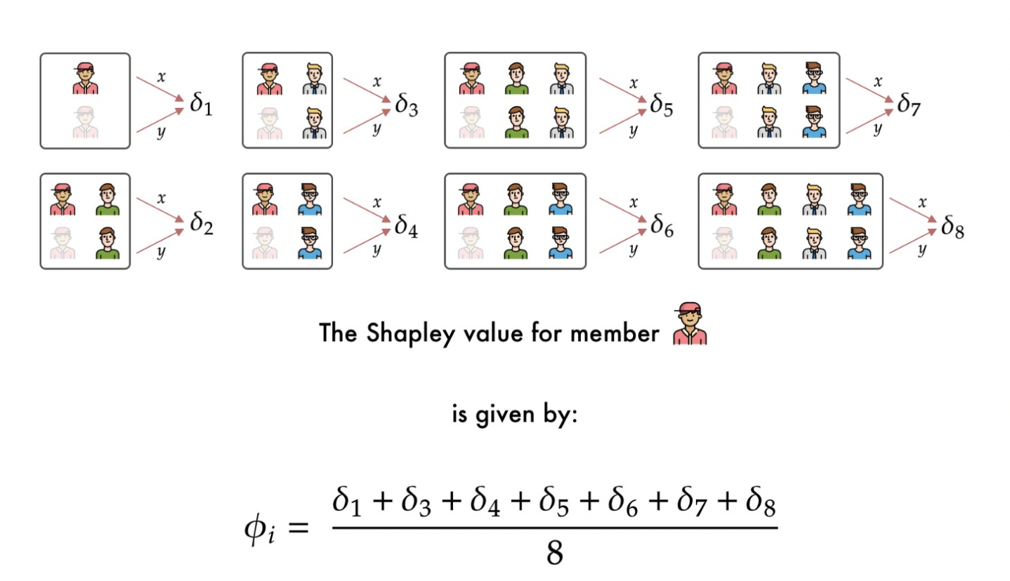
3. SHAP values
Marginal contribution of member A
Radiation
Vegetation
22 | XML

Slide 23
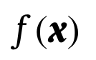

Machine learning (model-agnostic):
RAD
TA
VPD
SWC
CO2
NEP

Slide 24

RAD = 408 | TA = 19 | VPD = 9 | SWC = 46 | CO2 = 372
NEP*= 16
Decomposing prediction:
20

Slide 25
RAD = 408 | TA = 19 | VPD = 9 | SWC = 46 | CO2 = 372
20
SWC
+4
E(GPP) = 20, GPP* = 16
VPD
+6
RAD
-9
Tair
-4
CO2
-1
16

Slide 26
Step 1: Get a random permutation of the features
Original
RAD = 408 | TA = 19 | VPD = 9 | SWC = 46 | CO2 = 372
CO2 | RAD | SWC | TA | VPD

Slide 27
Step 2: Pick a random sample from the dataset
CO2 | RAD | SWC | TA | VPD
380 | 112 | 20 | 17 | 30

Slide 28
Step 3: Form two new samples
CO2 | RAD | SWC | TA | VPD
380 | 112 | 20 | 17 | 30
Random
CO2 | RAD | SWC | TA | VPD
372 | 408 | 46 | 19 | 9
Original

Slide 29
Step 3: Form two new samples (X1)
CO2 | RAD | SWC | TA | VPD
372 | 408 | 46 | 19 | 30
From the original sample
From the random sample

Slide 30
Step 3: Form two new samples (X2)
CO2 | RAD | SWC | TA | VPD
372 | 408 | 46 | 17 | 30
From the original sample
From the random sample

Slide 31
Step 4: Use the new samples to make predictions and find the difference in predictions
CO2 | RAD | SWC | TA | VPD
372 | 408 | 46 | 19 | 30
X1
16.8
CO2 | RAD | SWC | TA | VPD
372 | 408 | 46 | 17 | 30
X2
16.1
Contribution of TA: 16.8 – 16.1 = 0.7

Slide 32
Step 5: Repeat Steps 1–4 a couple of times and then calculate the average of the differences

Slide 33
3. SHAP values
Marginal contribution of member A
Radiation
Vegetation
33 | XML

Slide 34
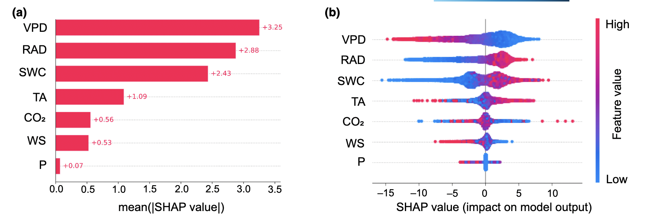
3. SHAP values
Example for continuous variables
Radiation
Vegetation
34 | XML

Slide 35
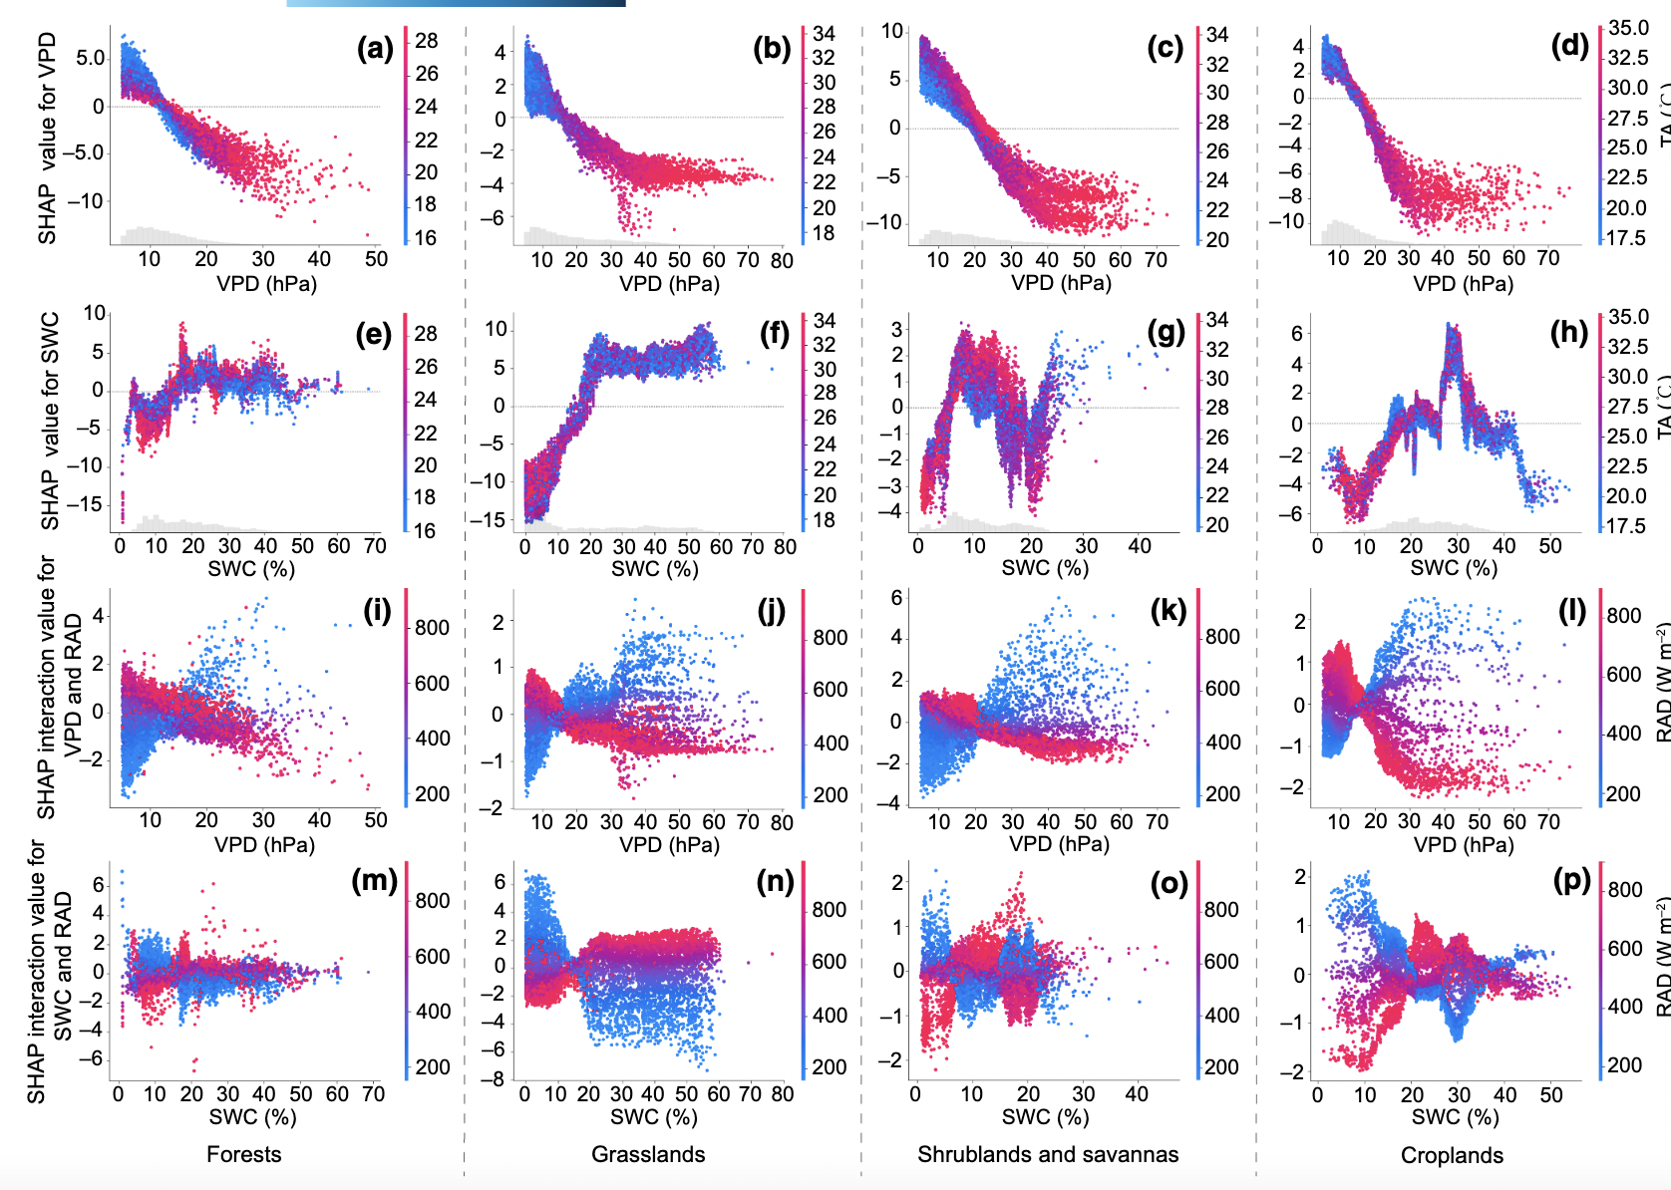
3. SHAP values
Example for continuous variables
Radiation
Vegetation
35 | XML

Slide 36
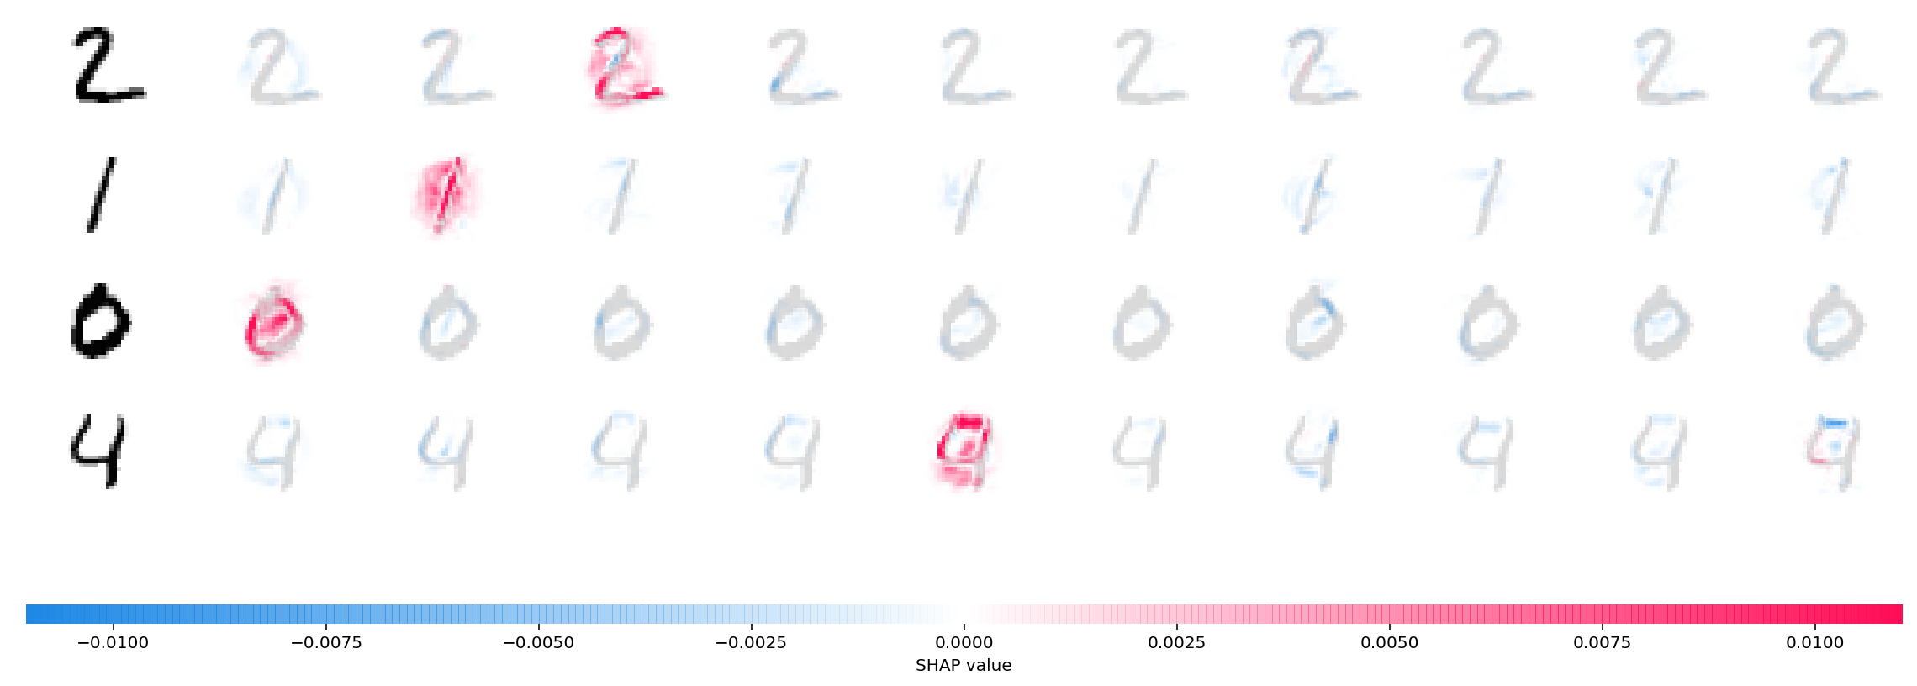
3. SHAP values
Example for images
Radiation
Vegetation
36 | XML

Slide 37
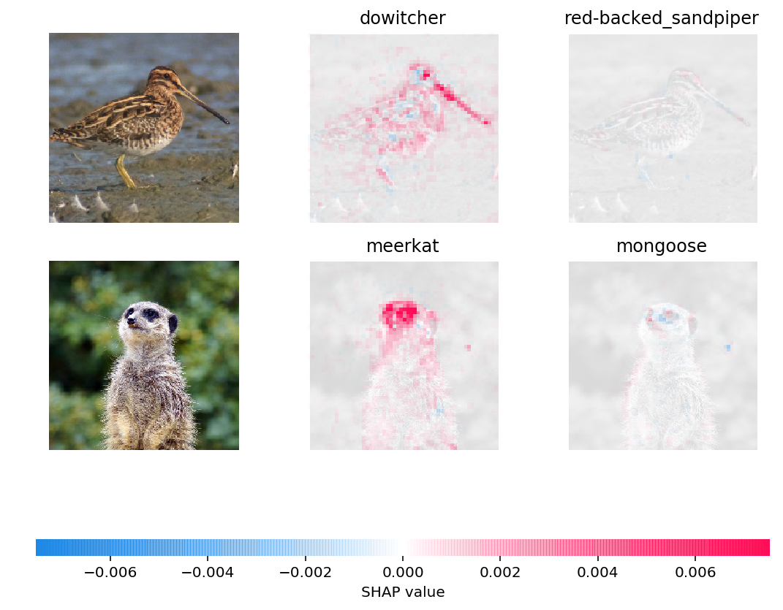
3. SHAP values
Example for images
Radiation
Vegetation
37 | XML

